Slide 1
The long 20th century in the United States

Slide 2
#1. The Post Civil War Years and the Turn of the Century (1870s-1917)
Social forces at play in the “Gilded Age”
Industry
Immigration
Cities
Populism and Progressivism
The price of the Gilded Age
The Progressive movement

Slide 4
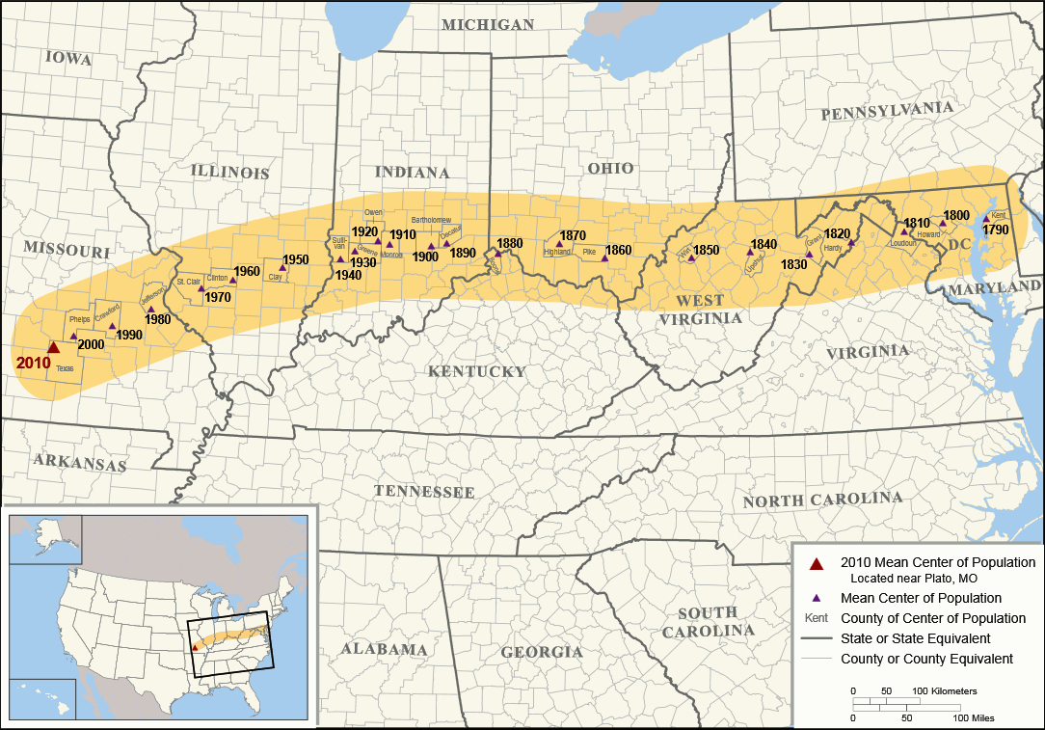

Slide 5
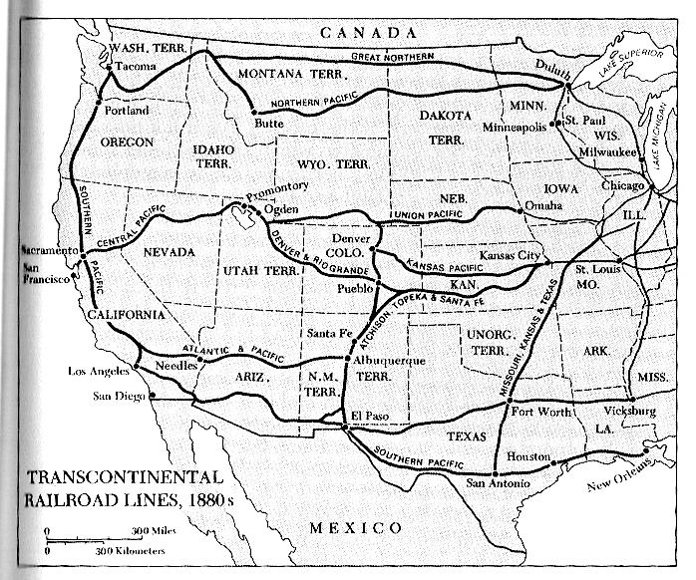
See also this map

Slide 6
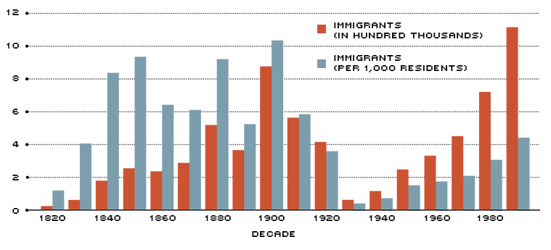

Slide 7
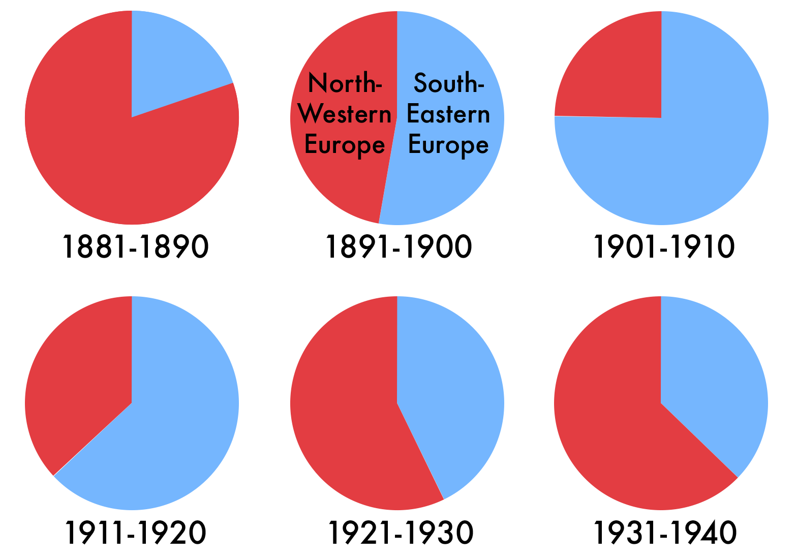
Immigration flows

Slide 8
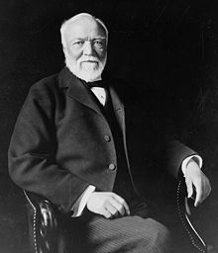
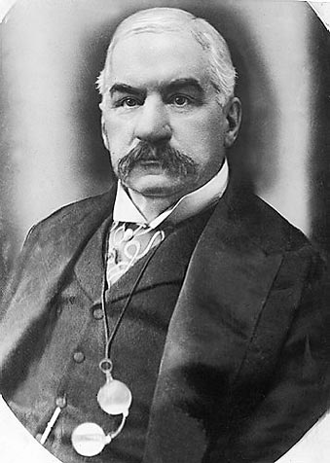
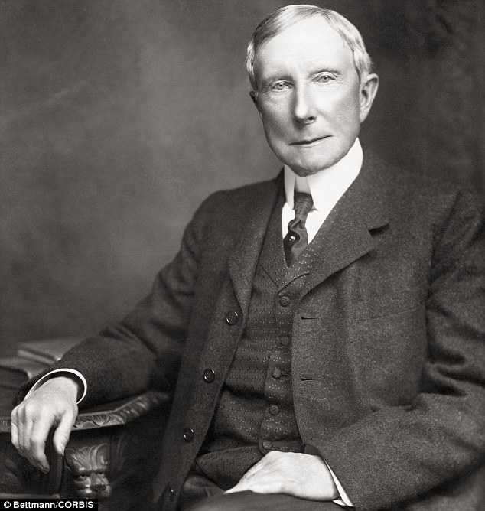
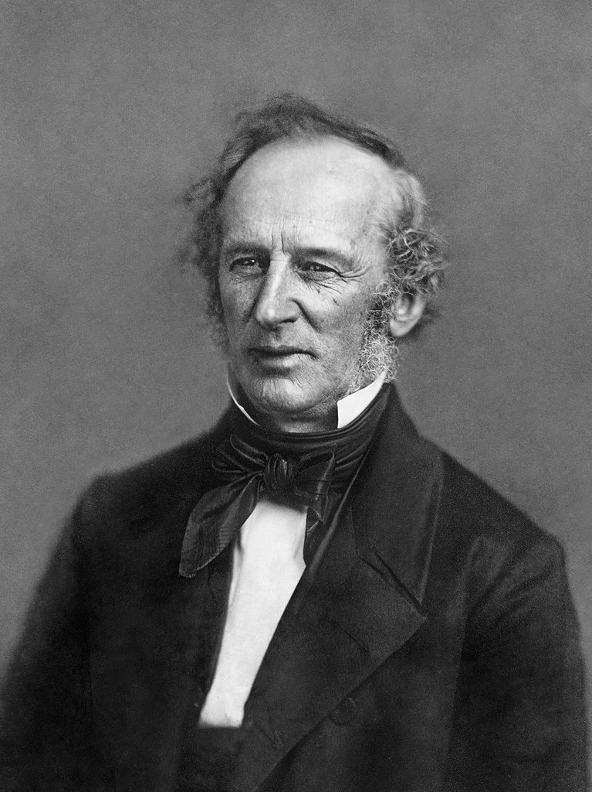
Andrew Carnegie
John Pierpont Morgan
John D. Rockefeller
Cornelius Vanderbilt

Slide 9
In orange the places gaining Black population, in blue/purple the places losing Black population

Slide 10
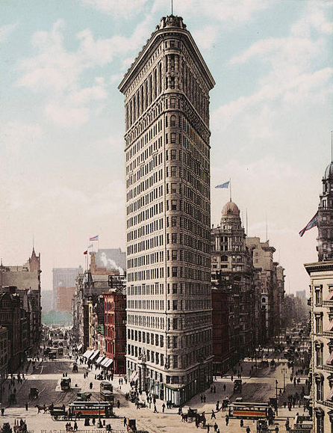
The Flatiron Building, ca 1903

Slide 11
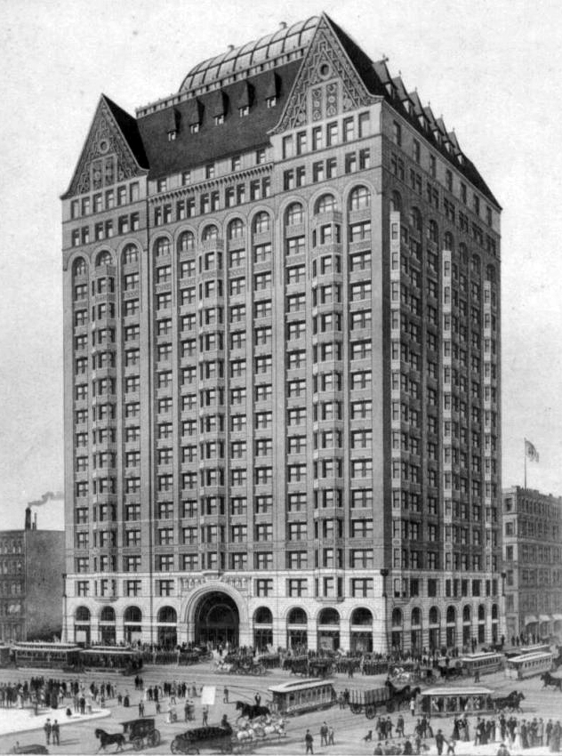
Chicago Masonic Temple (1892-1939)

Slide 12
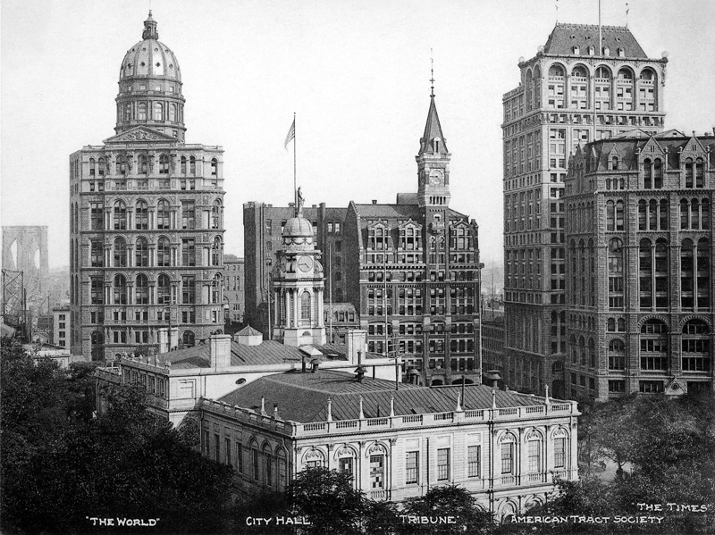
ca 1906

Slide 13
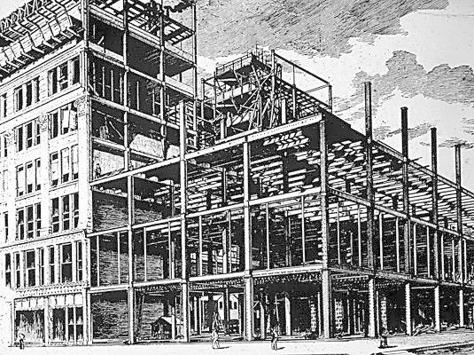

Slide 14
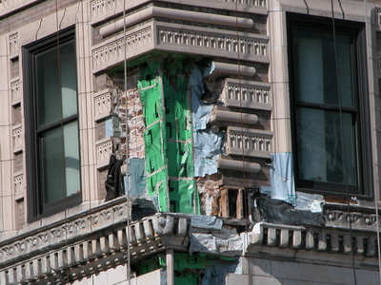
http://www.tboake.com/steel/skyscraper_chicago.html

