Slide 1
The 1950s

Slide 2
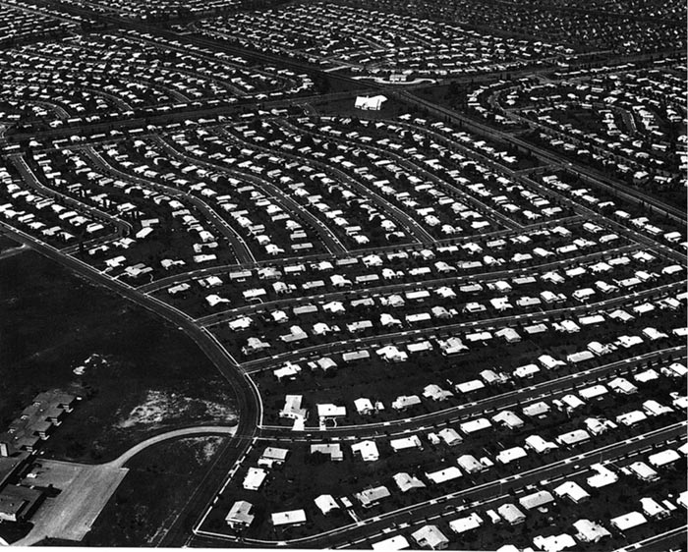
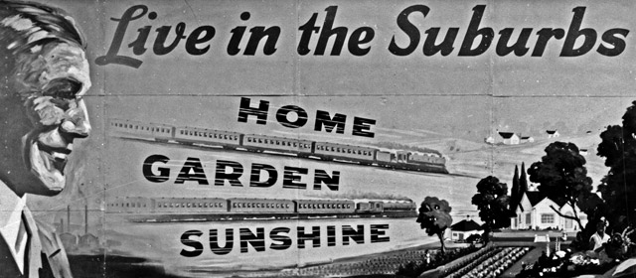
http://ushistoryscene.com/article/levittown/

Slide 3
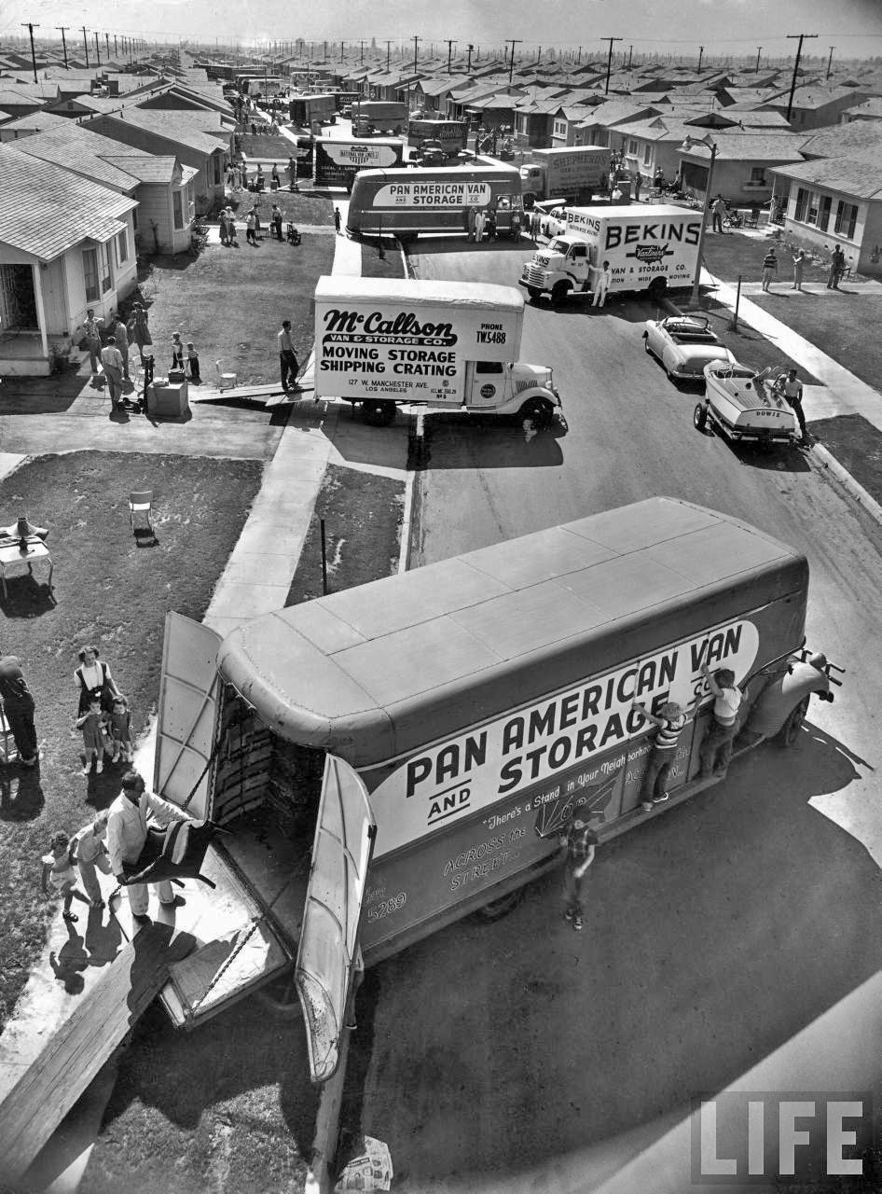

Slide 4
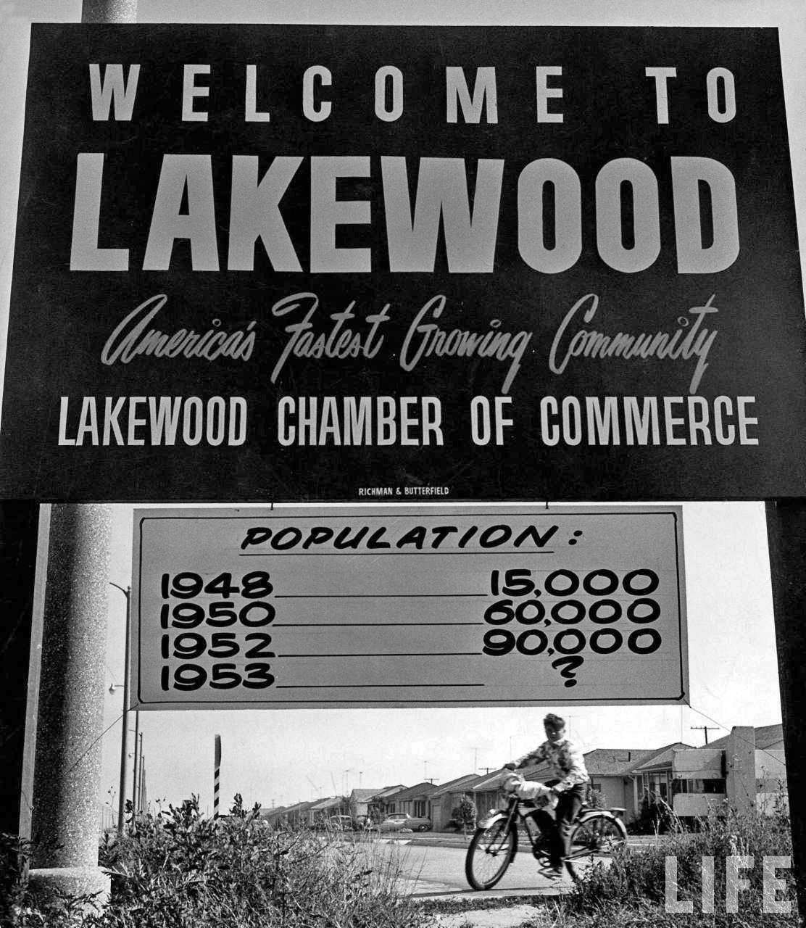

Slide 5
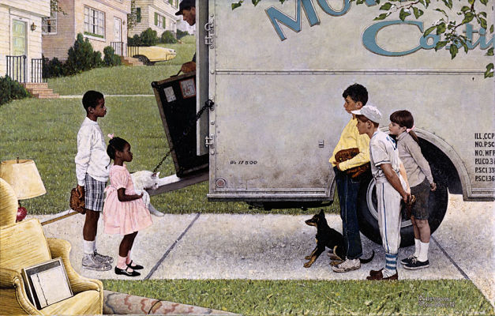
Norman Rockwell, New Kids in the Neighborhood, 1967 (Chicago Park Forest Community)

Slide 6
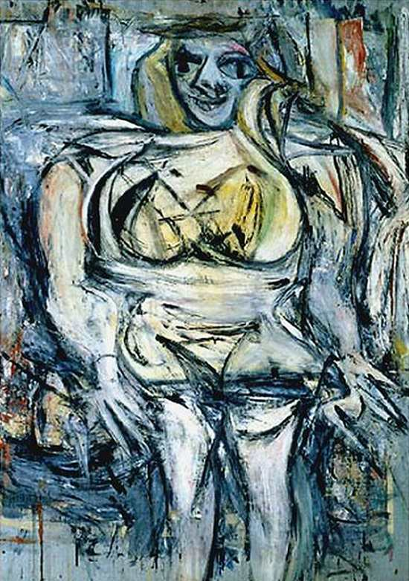
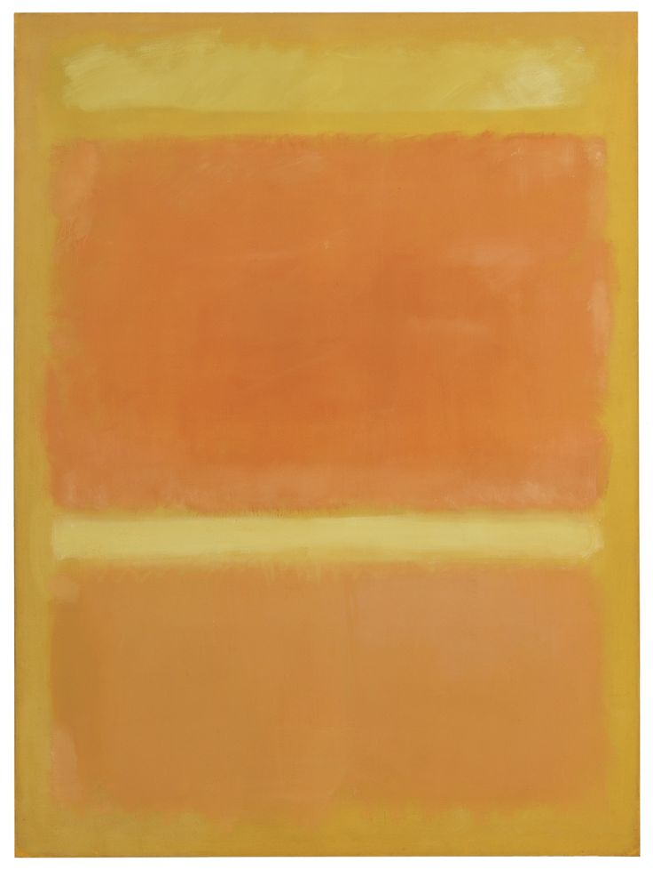
Woman III, William de Kooning, 1953
Mark Rothko, yellow orange yellow light orange1955

Slide 7
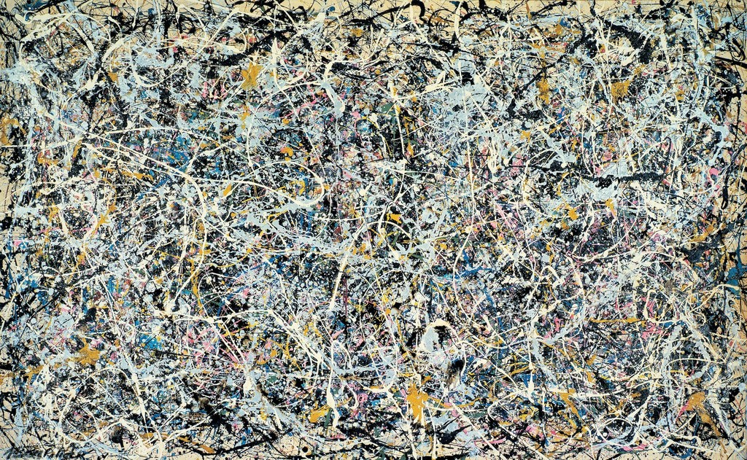
Jackson Pollock, Number 1, 1949, 1949. Enamel and metallic paint on canvas, 160 × 259.1 cm

Slide 8
http://ushistoryscene.com/article/westsocialmovements/
http://ushistoryscene.com/article/feminine-mystique/

