Slide 1
The 1920s

Slide 2
A movie theater, San Bernardino, CA, 1928

Slide 3
A movie theater, 1920

Slide 4
A movie theater, Houston, 1926

Slide 5
Rudolph Valentino (1895-1926), Son of the Sheik (1926) with Vilma Banky

Slide 6
1923 (left), 1928 (right)

Slide 7
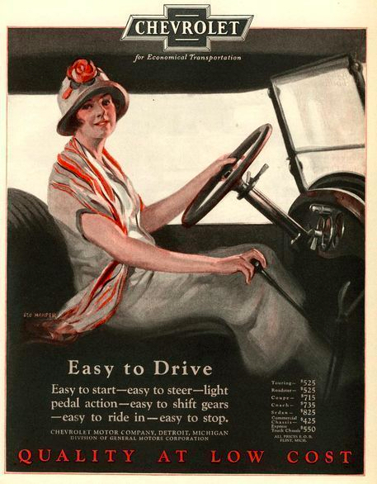
1925

Slide 8
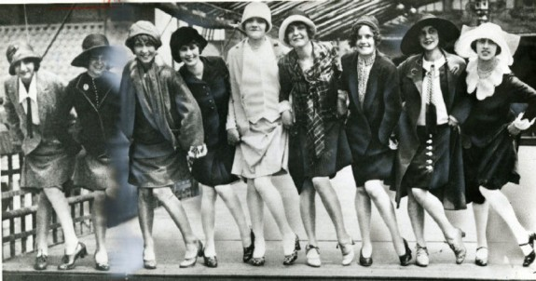
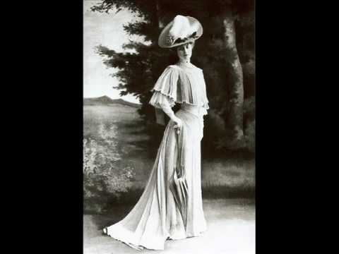
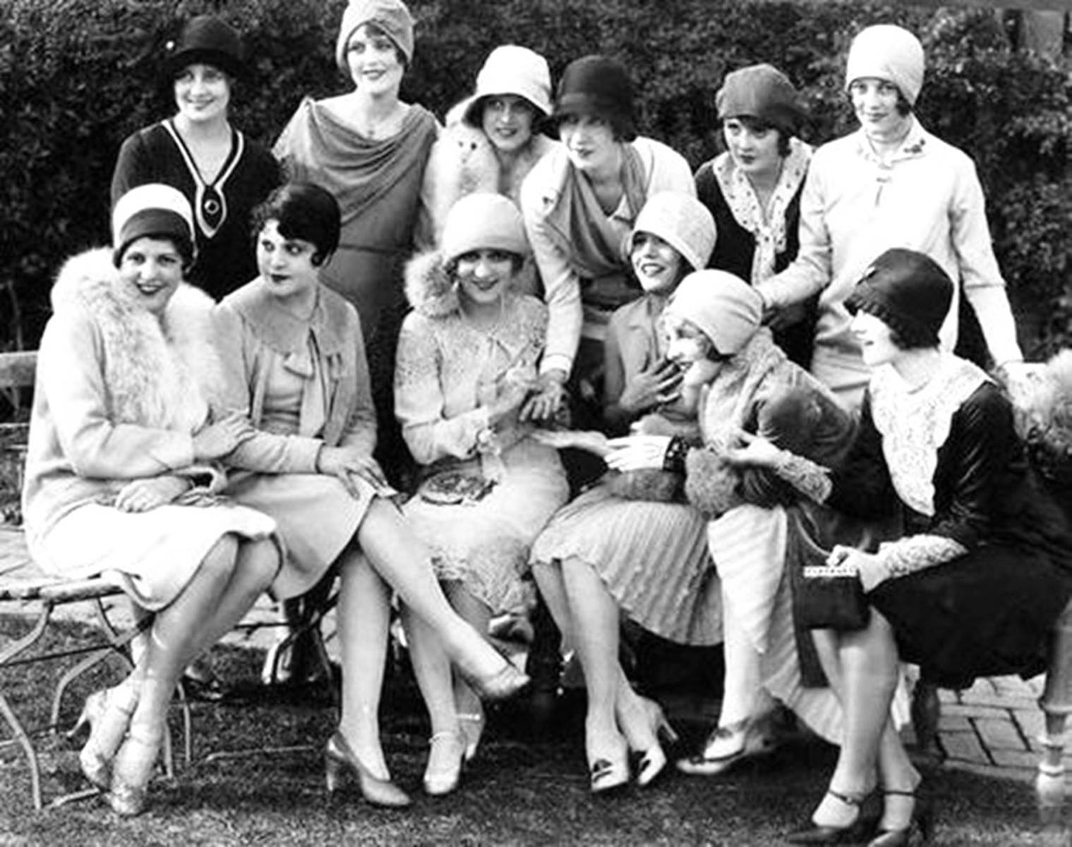
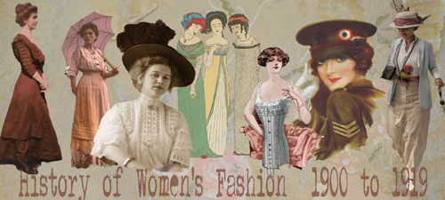
Flappers

Slide 9
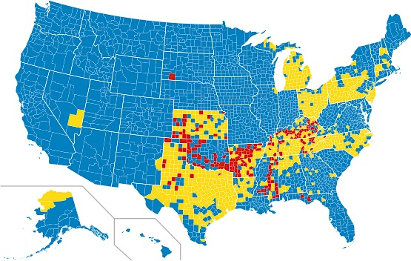
Dry (red), wet (blue), and mixed (yellow) counties in the United States, 2017

Slide 10
Cartoons and ads from the 1920s

Slide 11
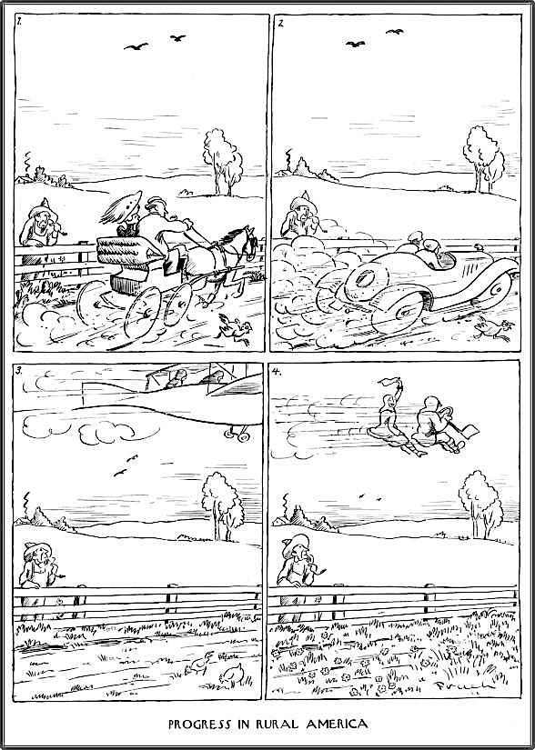
The New Yorker, 1927

Slide 12
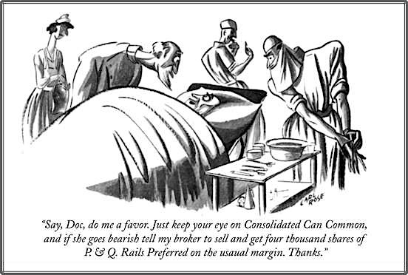
1929
1927

Slide 13
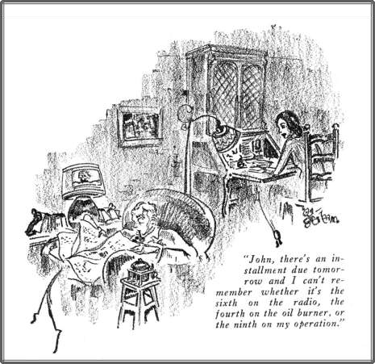
1927

Slide 14
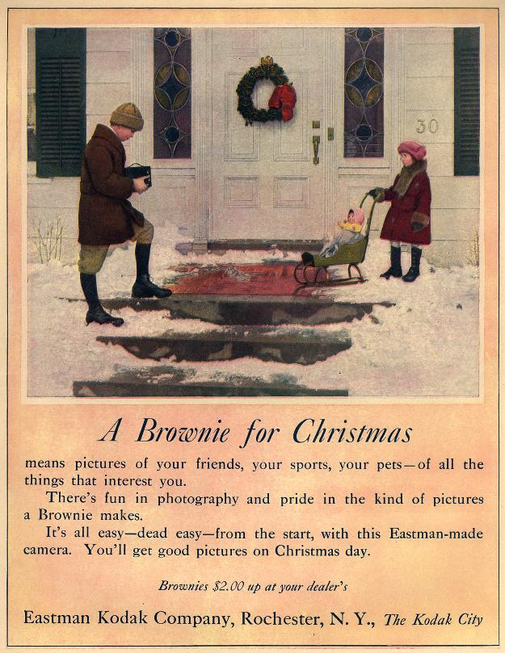
1922

Slide 15
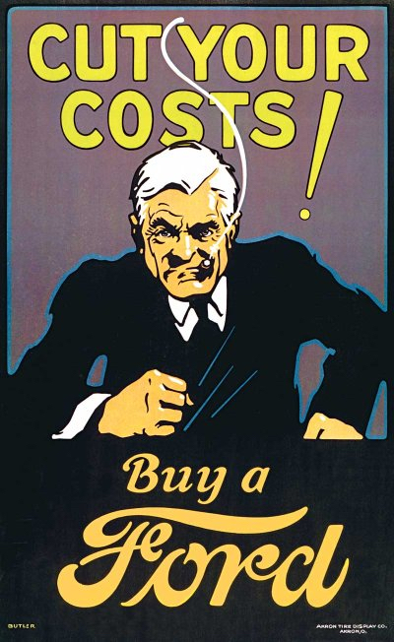

Slide 16
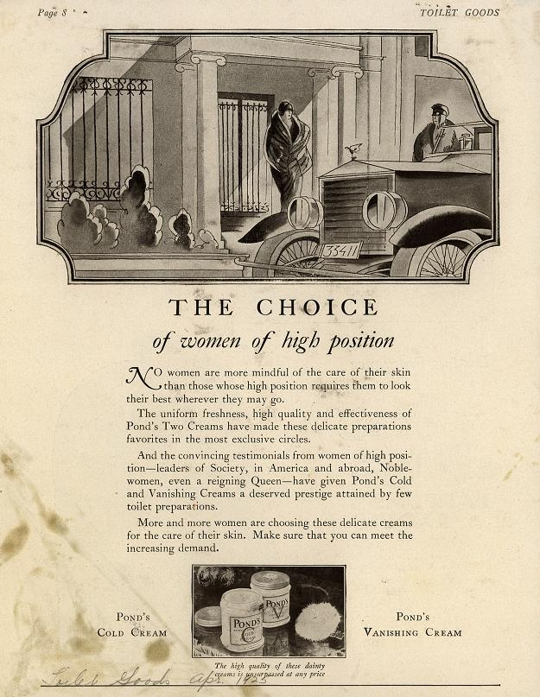
1925

Slide 17
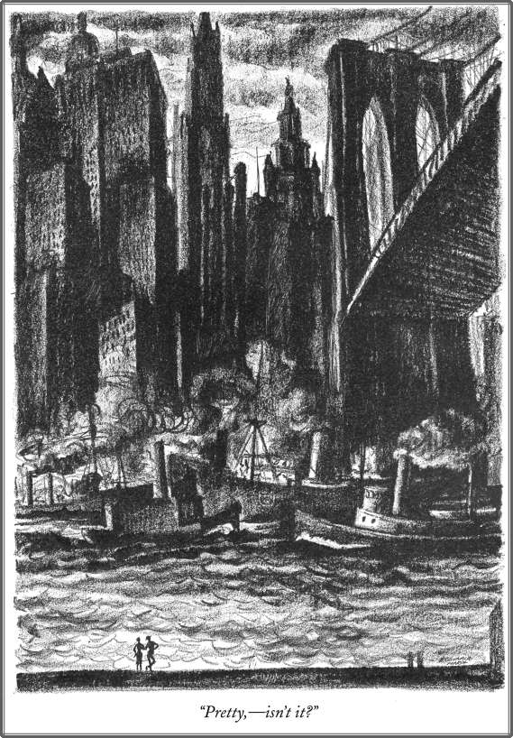
The New Yorker, 1925

Slide 18
Wrigley building, 1924 (left), Chicago Tribune, 1925 (right)

Slide 19
Chrysler building, NYC (1930)

Slide 20
Chrysler building, NYC (1930)

