Slide 1
American buildings of the turn of the century

Slide 2
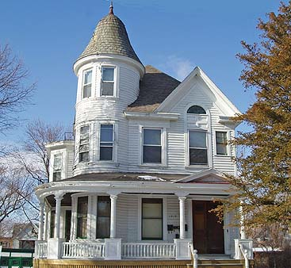
Queene Anne style

Slide 3
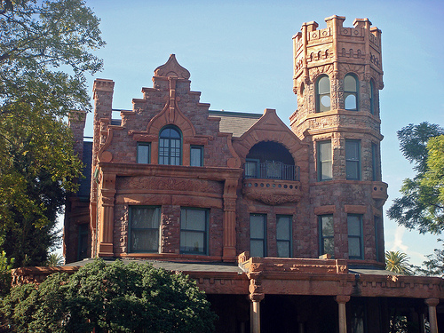
Stimson House, Los Angeles, 1891

Slide 4
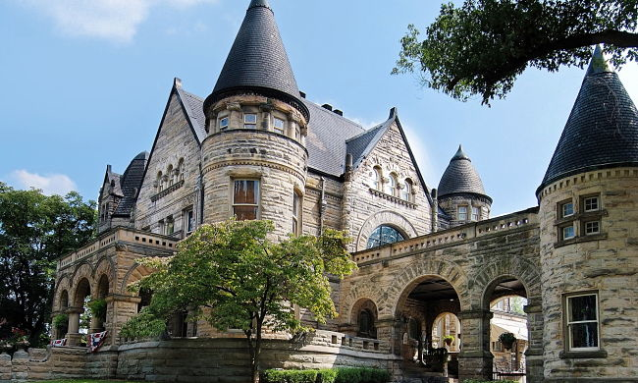
Buhl Mansion, Sharon, PA, 1891

Slide 5
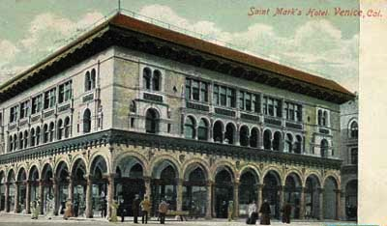
Venice, California, ca 1907

Slide 6
Venice, California, 1909

Slide 7
Columbian Exposition, Chicago, 1893

Slide 8
Columbian Exposition, Chicago, 1893

Slide 9
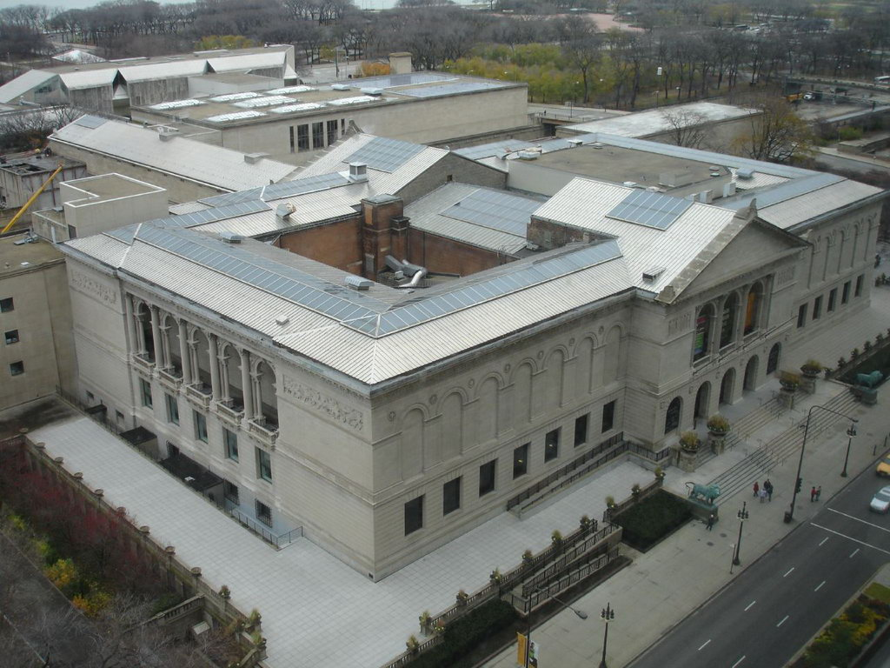
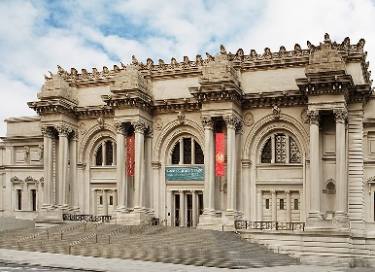
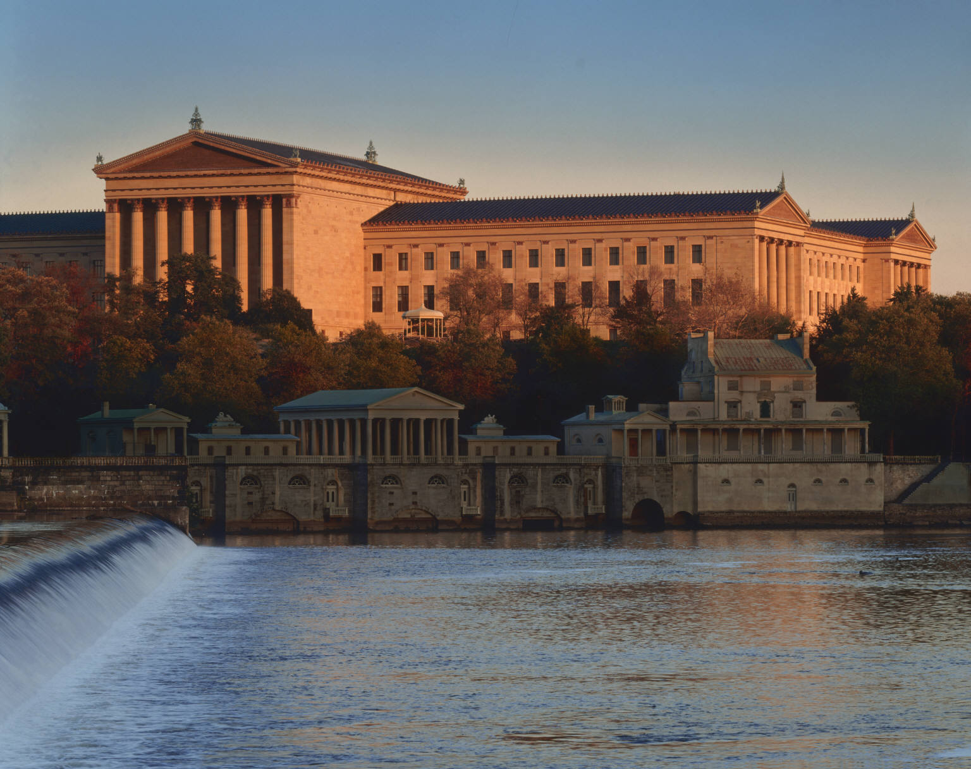
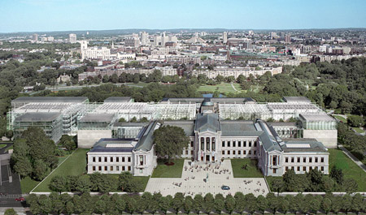
Art Institute of Chicago, 1893
Metropolitan Museum of Art, New York City, 1874
Philadelphia Museum of Art, 1876
Boston Museum of Fine Arts, 1870

Slide 10
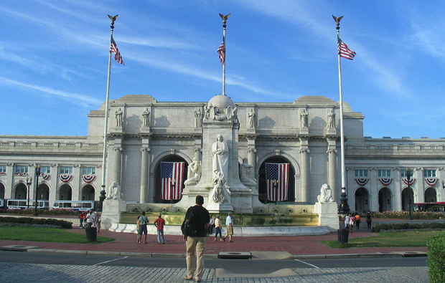
Union Station, Washington D.C., 1907

Slide 11
Union Station, Washington D.C., 1907

Slide 12
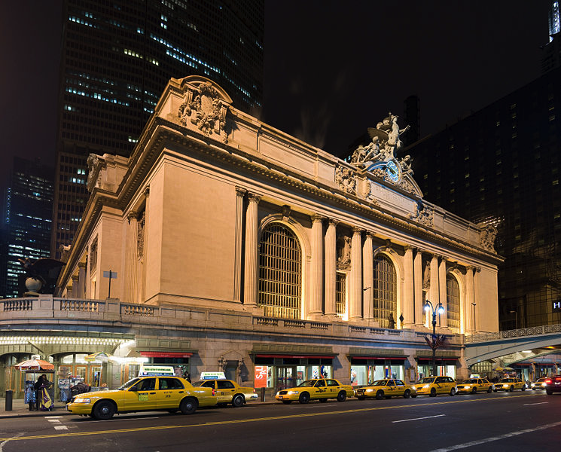
Grand Central Station, NYC, 1903

Slide 13
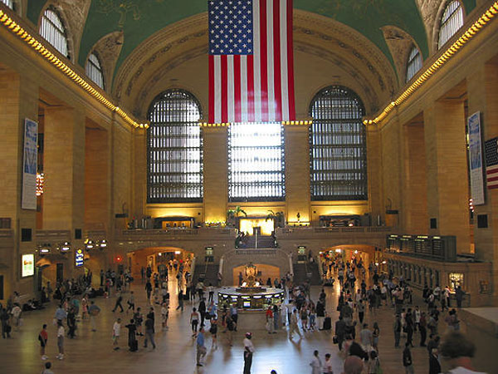
Grand Central Station Main Concourse, NYC, 1903

Slide 14
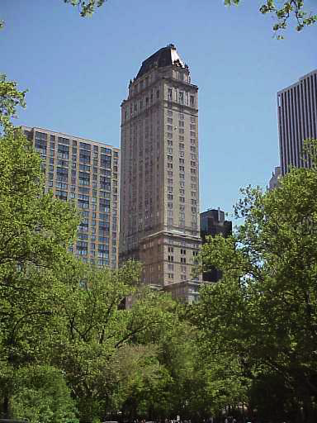
The Pierre (hotel), NYC,1930

Slide 15
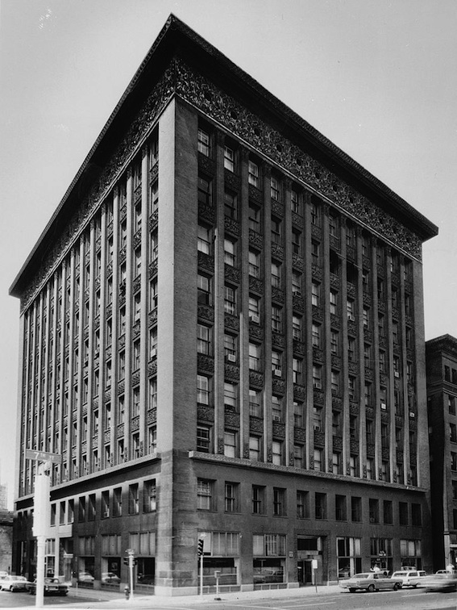
Wainwright Building, 1891 (Louis Sullivan)

Slide 16
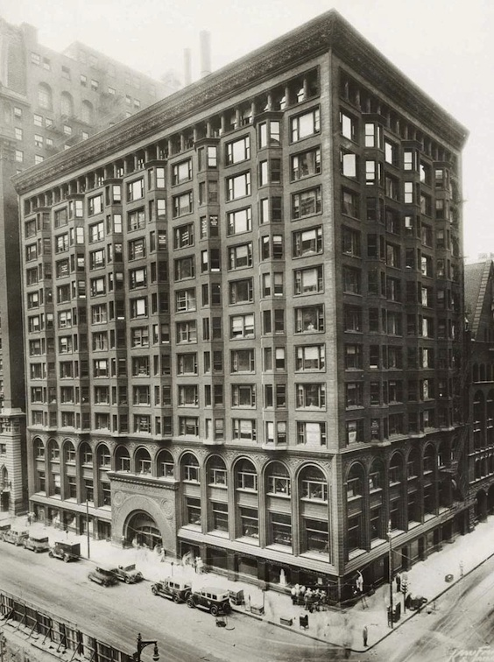
Chicago Stock Exchange, 1894 (Louis Sullivan)

Slide 17
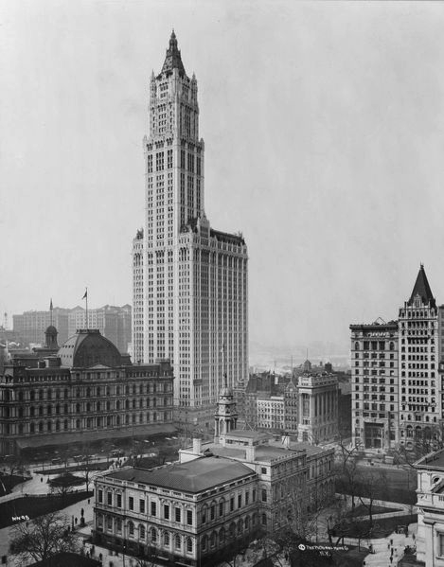
Woolworth building, NYC, 1913

Slide 18
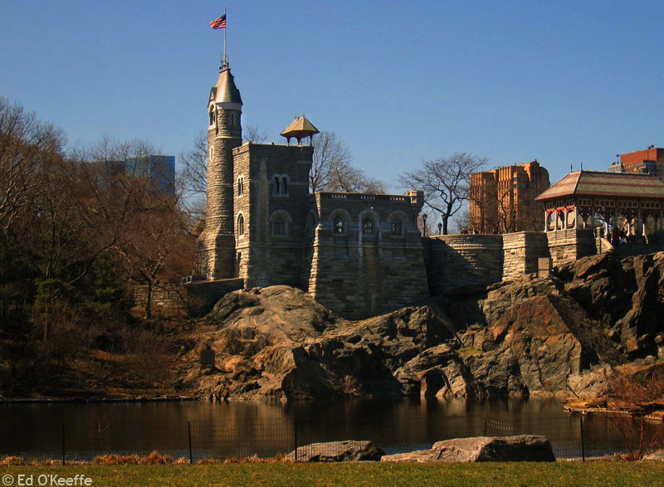
Belvedere Castle, Central Park (built, 1869)

Slide 19
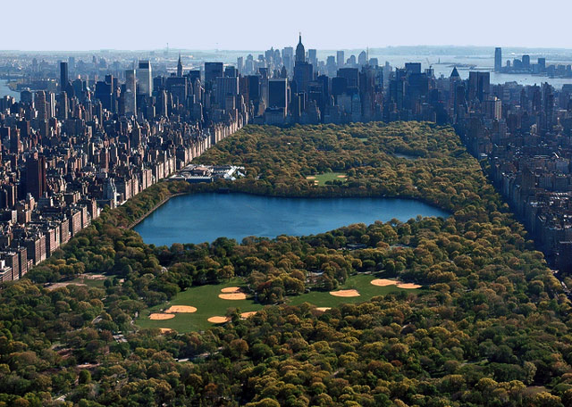
Central Park, NYC, 1857-1873

Slide 20
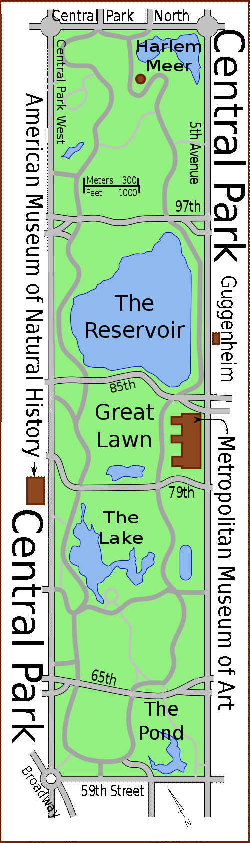

Slide 21
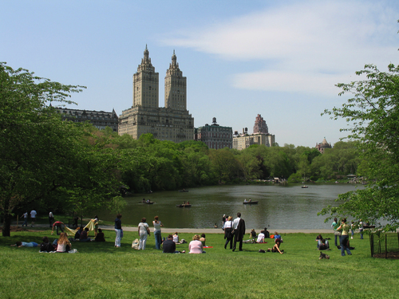
Central Park, NYC, 1857-1873

Slide 22
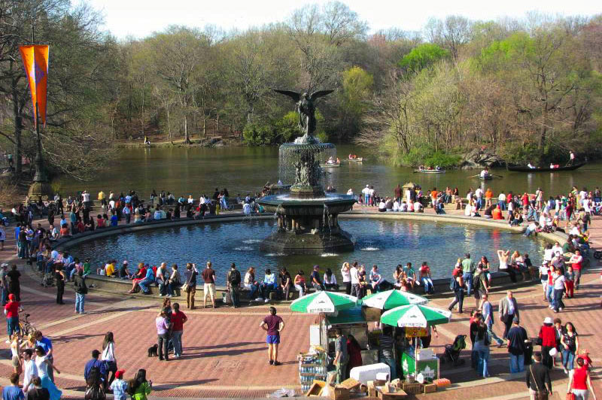
Central Park, NYC, Bethesda Fountain,1873

Slide 23
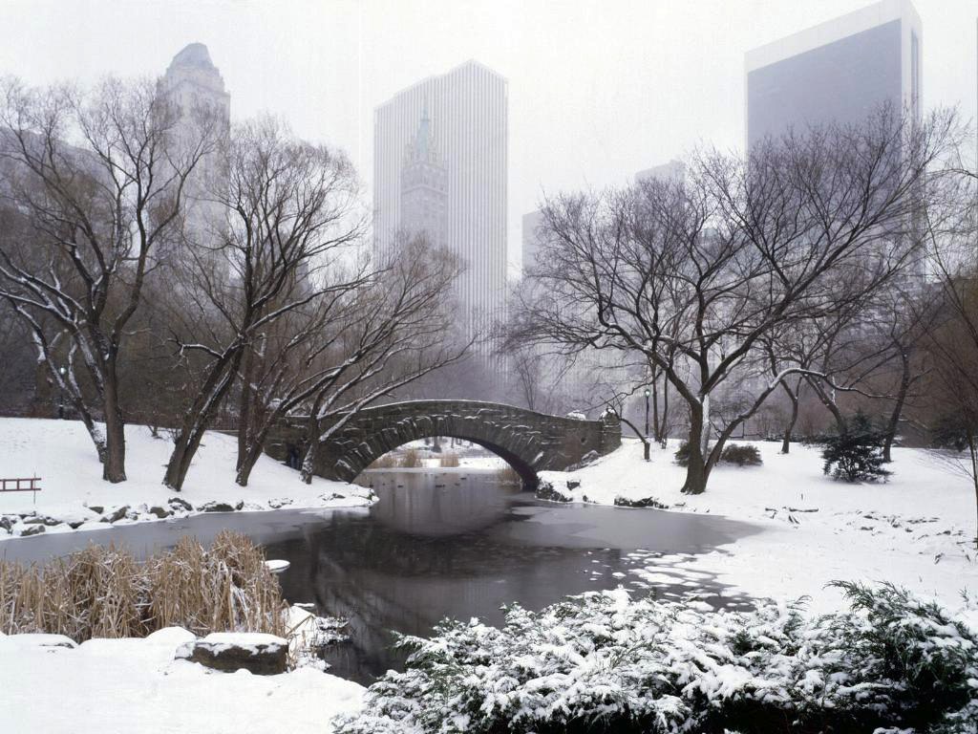
Central Park, NYC, 1857-1873

Slide 24
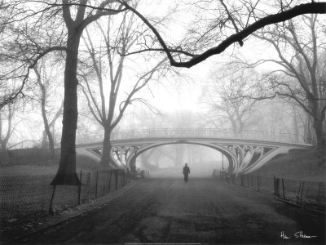
Central Park, NYC, 1857-1873

