Slide 1
Victorian Monsters
The end of a century and the end of a world

Slide 2
The mapping of the inside of man/woman
The rise of psychiatry and psychology.
The specificity of the Victorian gothic.
→ Contamination, degeneracy, and corruption.
Dracula as a metaphor of the age.
Both in Dracula and in The Strange Case of Dr Jekyll and Mr Hyde, the epistolary narration adds to the fragmentary perception of a complex world.

Slide 3
Monstrosity and ambiguity
Impossible to look at it in the eyes (remember the example of the mythological gorgon and Medusa).
An object of oblique perception and enjoyment.
Ambiguous monsters.
Anxiety or/and desire.
The power of attraction of evil.

Slide 4
The monster, a metaphor of the age
The contamination that could put an end to British civilisation.
The epidemic of syphilis.
The fear of losing control of one’s destiny and oneself.
The fundamental pessimism of the Victorian gothic.

Slide 5
The central figure of the double
Literature supported by psychological intuitions (the age of the rise of psychiatry).
The other oneself in The Strange Case of Dr Jekyll and Mr Hyde, Dracula, The Picture of Dorian Gray.
The double inside / the foreign double / the artistic double.
The self is always threatened by the presence of its dark double and the inner double is deadly.

Slide 6
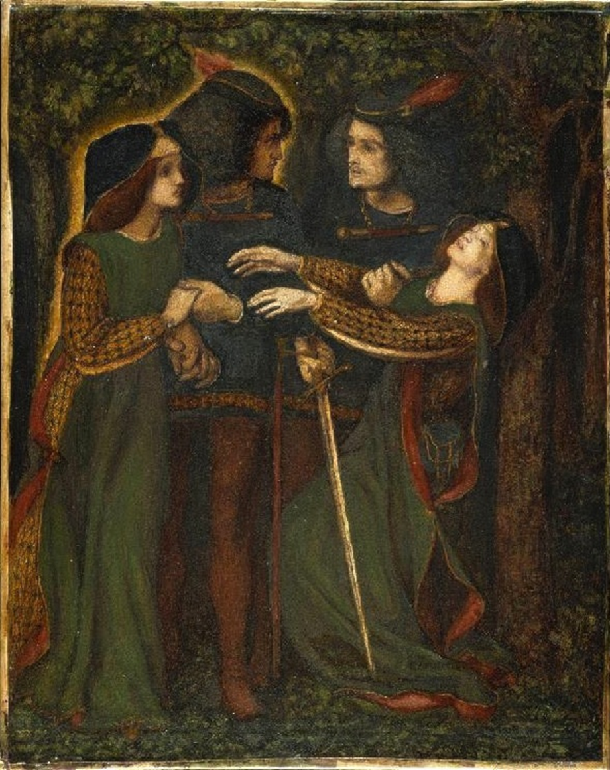
“How they met themselves”, Dante Gabriel Rossetti, 1864

